Slide 1
Spoken Syntax
Conversation Circles

Slide 2
Key Points
How should spoken language be corrected, if at all?
Normal types of oral corrective feedback
  Least and most effective feedback types
Setting up a situation where feedback can take place in the most useful manner
  Topics of conversation leading to certain types of errors
  Isolating errors
  Using the least intrusive possible method of correction
Gestural cue repertoire to be taught explicitly to students

Slide 3
Fundamental questions about error correction
Hendrickson (1978) asked the following:
  1. Should learners’ errors be corrected?
  2. When should learners’ errors be corrected? Which errors should be corrected?
  3. How should errors be corrected?
  4. Who should do the correcting?
Lyster & Ranta observed in 1997 that “we are hardly any closer to knowing the answers to these deceptively simple questions.”

Slide 4
Frequency of error correction
Allen et al. (1990) found that in practice, error treatment is dealt with in a “confusing and unsystematic” way.
Only 19% of grammatical errors are actually corrected, and most corrections seem to motivated by ‘an irritation factor’ (Lyster & Ranta (1997).

Slide 5
Basic types of oral corrective feedback (Lyster & Ranta)
Lyster & Ranta distinguish six types of feedback normally used by teachers in their study. Student utterances are keyed in red. Teacher interventions are keyed in green.
1. Explicit correction: I go yesterday. You mean “I went yesterday.
2. Recasts: My sister she go. Your sister goes?
3. Clarification requests: We stop with red light. What?
4. Metalinguistic feedback: I discover many error. One error? Singular?
5. Elicitation: I marry with my wife in March. How do we say that in English?
6. Repetition: The teacher want I go. The teacher want I go?

Slide 6
Most effective for uptake and repair
Students respond more successfully when the correct form is not supplied for them and there is negotiation of form, i.e., with
  Clarification requests
  Metalinguistic feedback
  Elicitation
  Error correction
      (Dr. Olenka Bilash, http://www.educ.ualberta.ca/staff/olenka.bilash/best%20of%20bilash/error%correction.html)

Slide 7
#7 – Silent feedback based on ASL or hand gestures
Doesn’t interrupt the flow of speech
In real time, allows teacher to draw attention to the specific error, usually without naming it
Can be followed by metalinguistic feedback if necessary
Can be followed by a mini-lesson on the error if necessary (but this interrupts the flow, so it has to be “worth” the time-out in the judgment of the teacher)

Slide 8
Flowchart for SS oral corrective feedback (repair of form)
Error
a) Gestural cue
b) Metalinguistic cue
Self- or peer- correction
Students note correction for review later

Slide 9
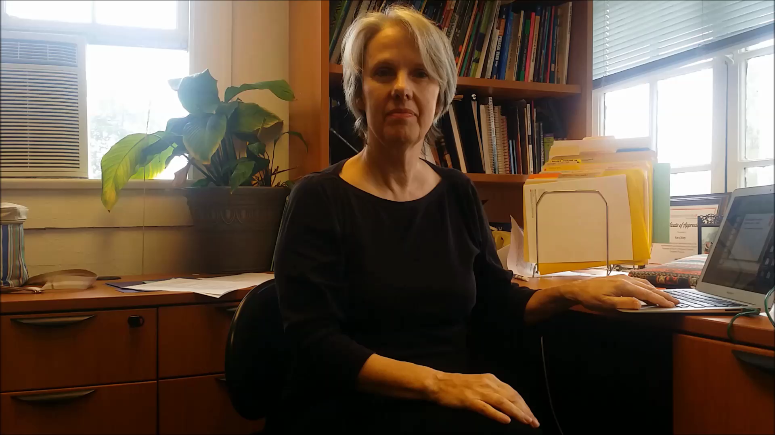
Verb cues – Past tense
To elicit past tense, gesture over shoulder to the rear.

Slide 10
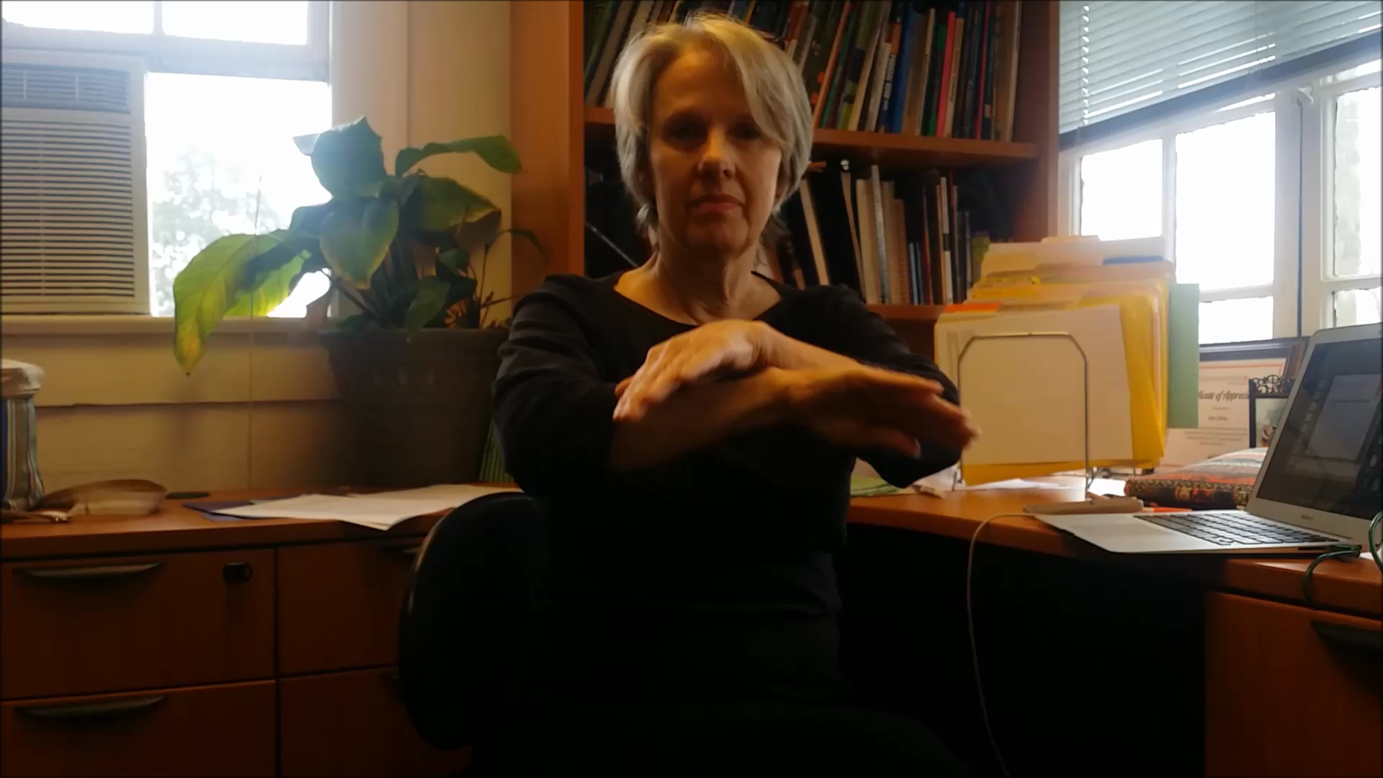
Present– “all the time” tense
To elicit present tense, make an arc with both hands (all-the-time tense)

Slide 11
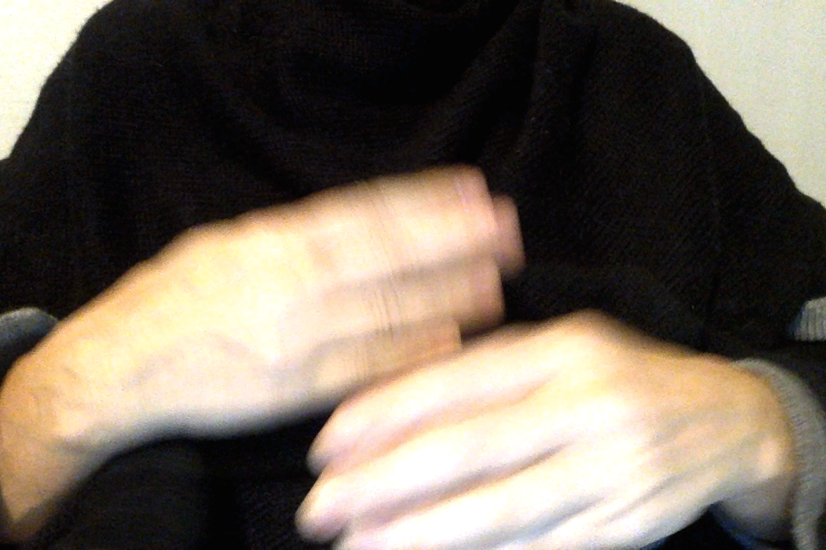
Future Tense
To elicit future tense, hands circle each other, ending with forward motion

Slide 12
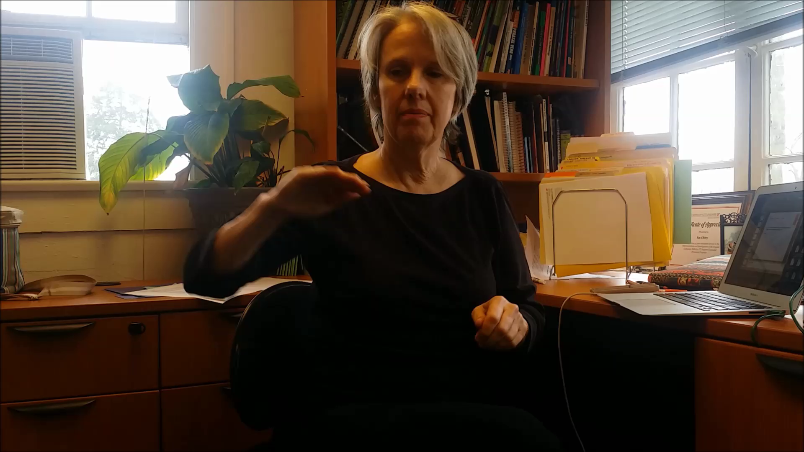
Present perfect tense
To elicit present perfect tense, cup right hand and move from right side to front of body (past to present).

Slide 13
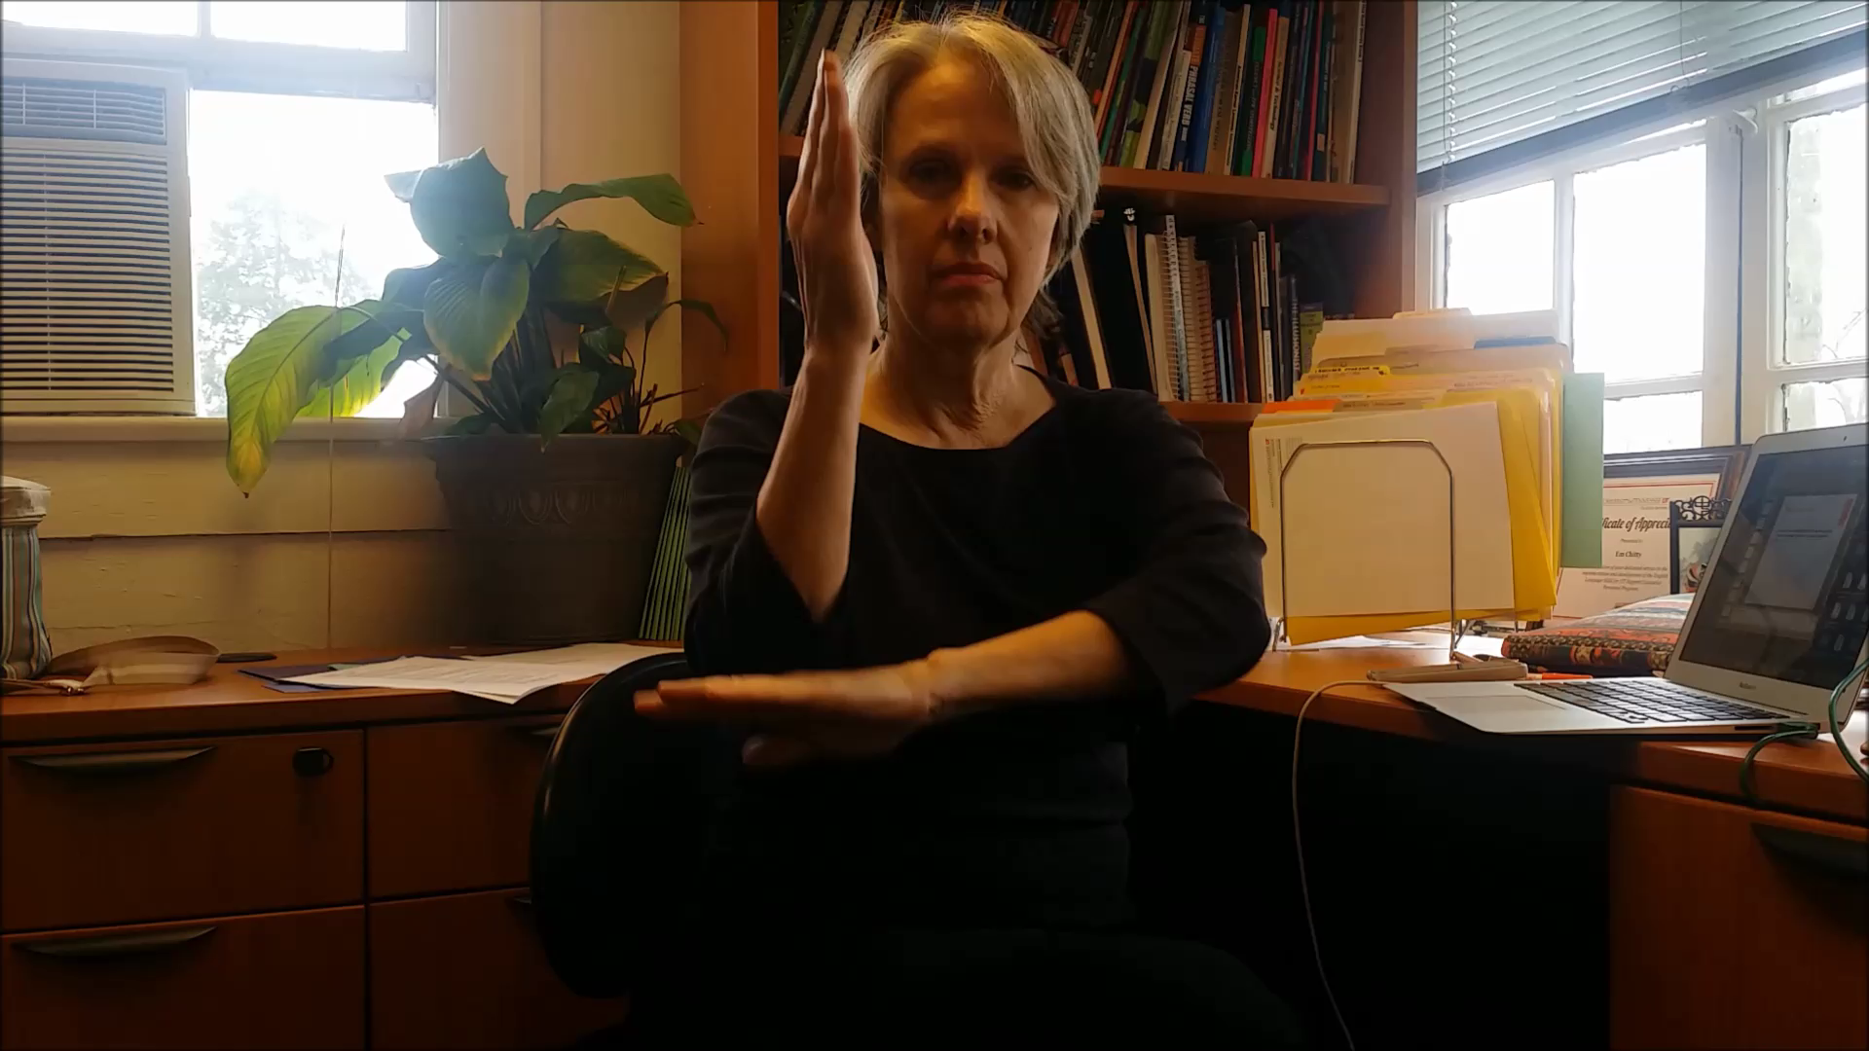
Missing “be” verb
To elicit the verb IS/ARE/WAS/WERE in a sentence, holding left arm flat with right arm elbow touching it, point up with right

Slide 14
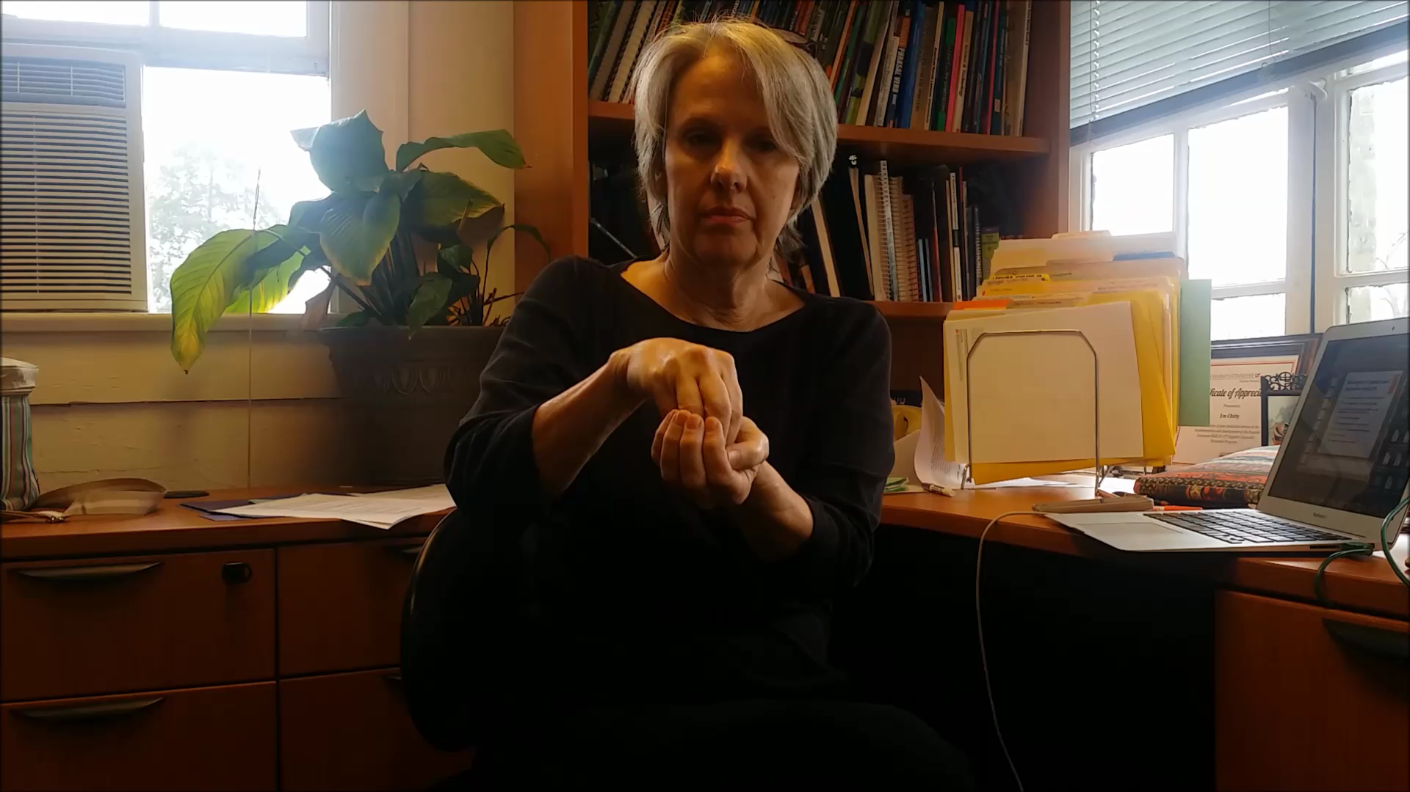
Gestural cues 2 prepositions and particles
“In” cup left hand, gather fingers of right hand and put in “cup.”

Slide 15
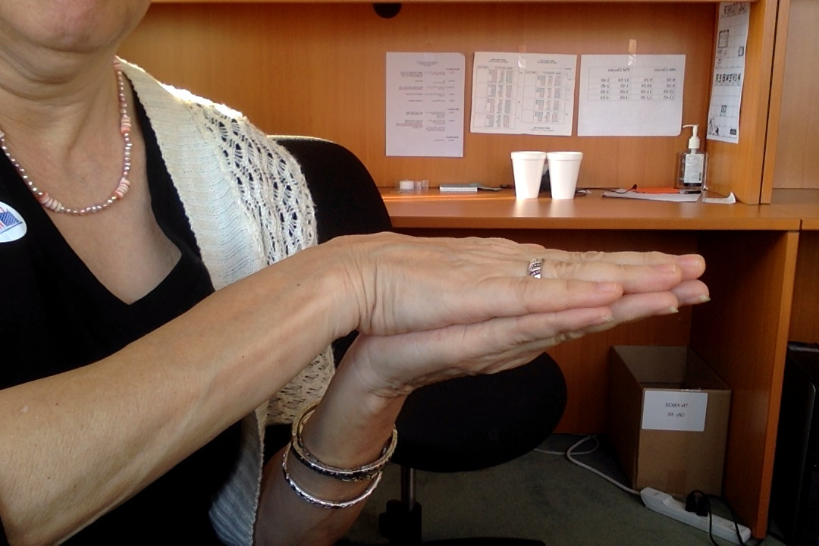
On--contacting
“On” two flat hands, one on top touching the other

Slide 16
On (continuing) hands circle around each other

Slide 17
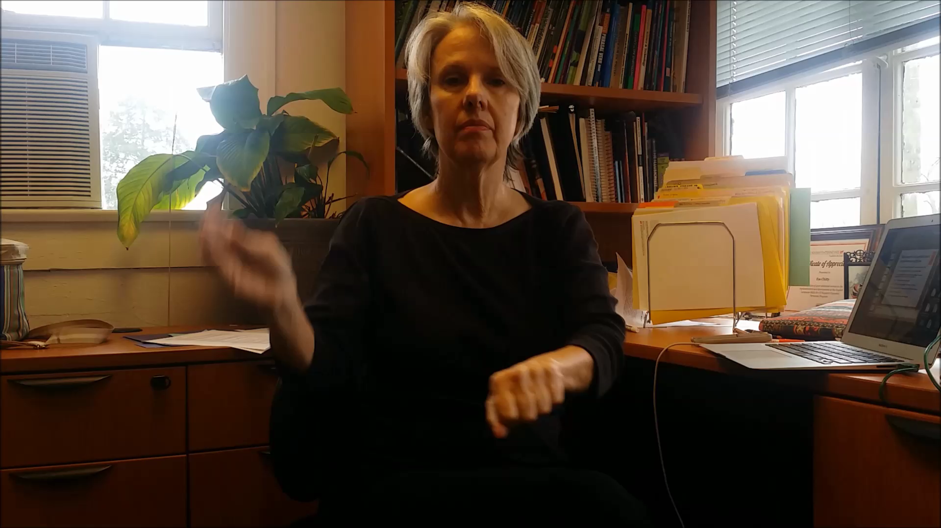
At
“At” with left hand out, gather fingers of right hand, cross over left arm (out of “sight,” over the barrier of the arm)

Slide 18
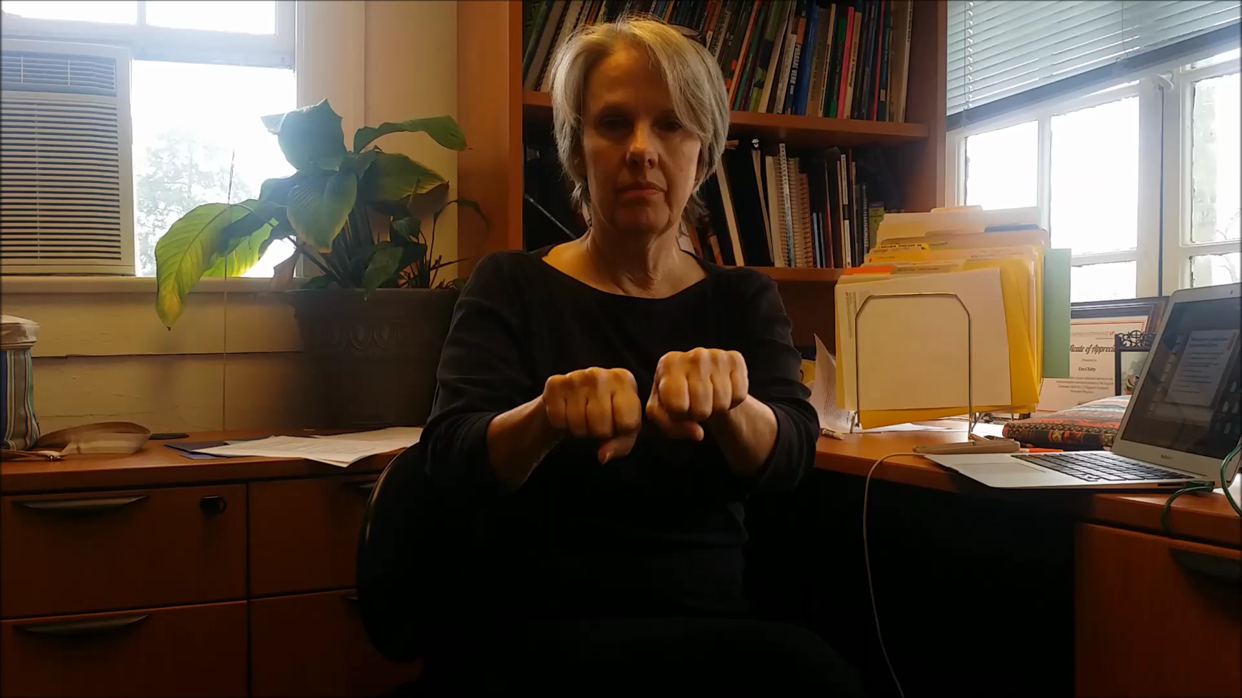
With
“With” two fists side by side

Slide 19
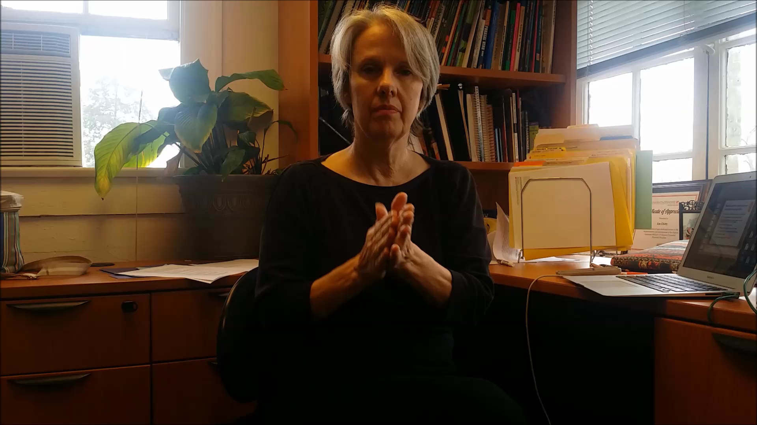
To
“To” With palms touching, move right hand out in front.

Slide 20
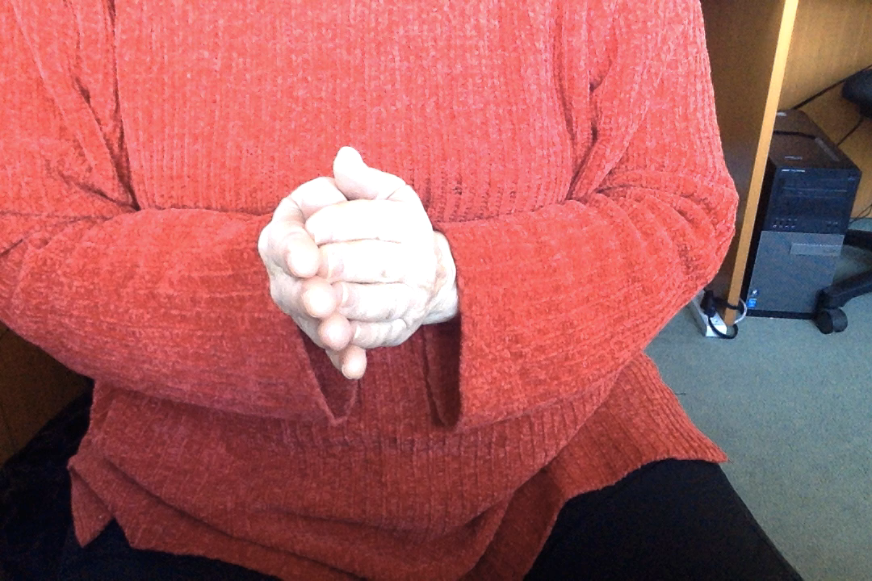
For
Hands start to make sign for “to”—right hand veers to side.

Slide 21
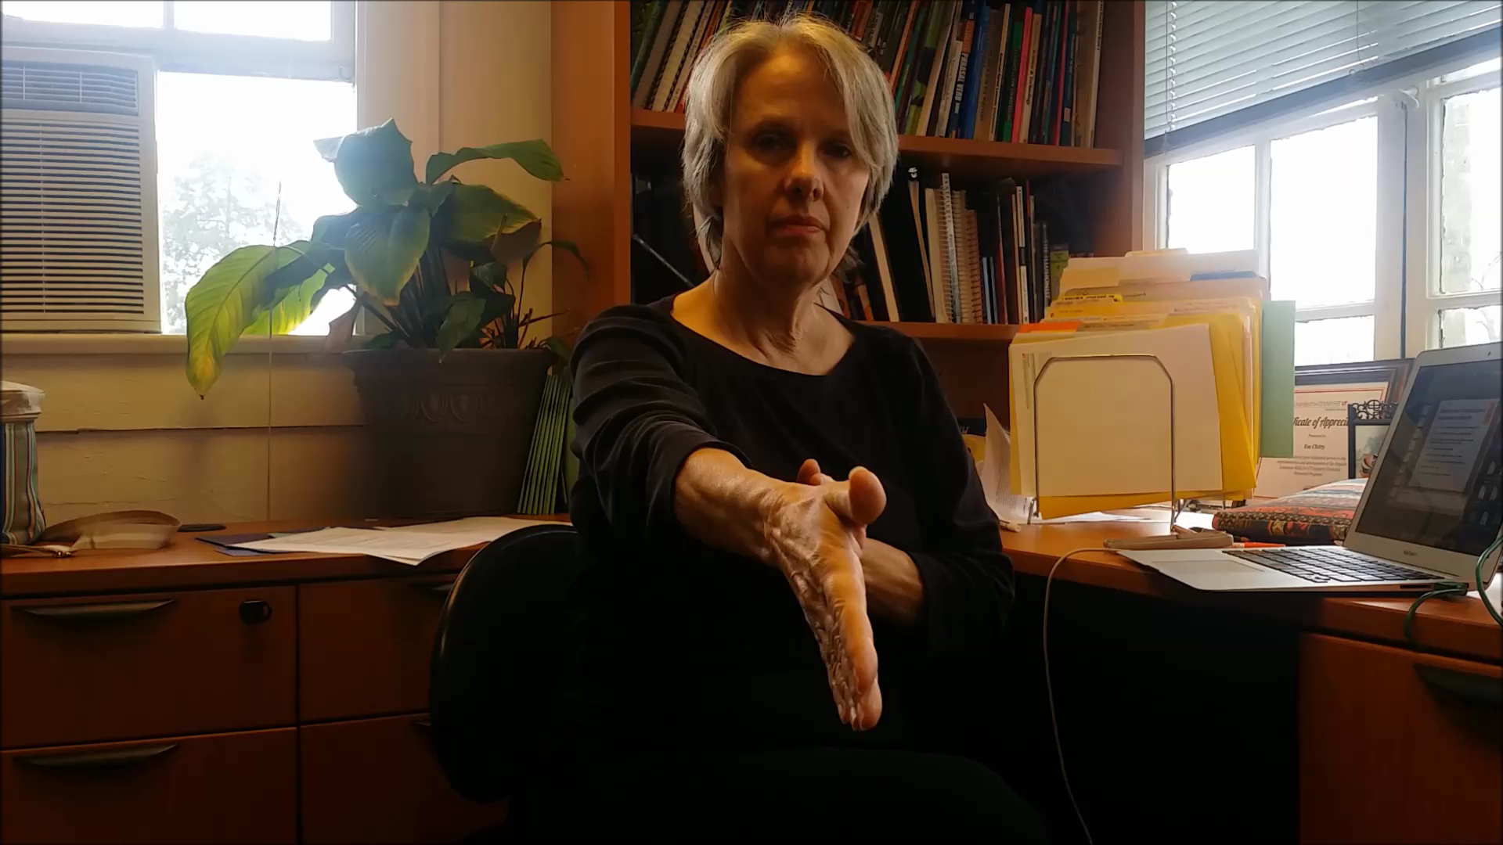
From
“From” Opposite of “to”– hands move together to touch palms

Slide 22
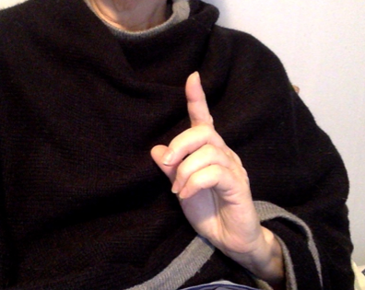
Gestural cues 3—articles
A or an
  Index finger up for “a” or “an”

Slide 23
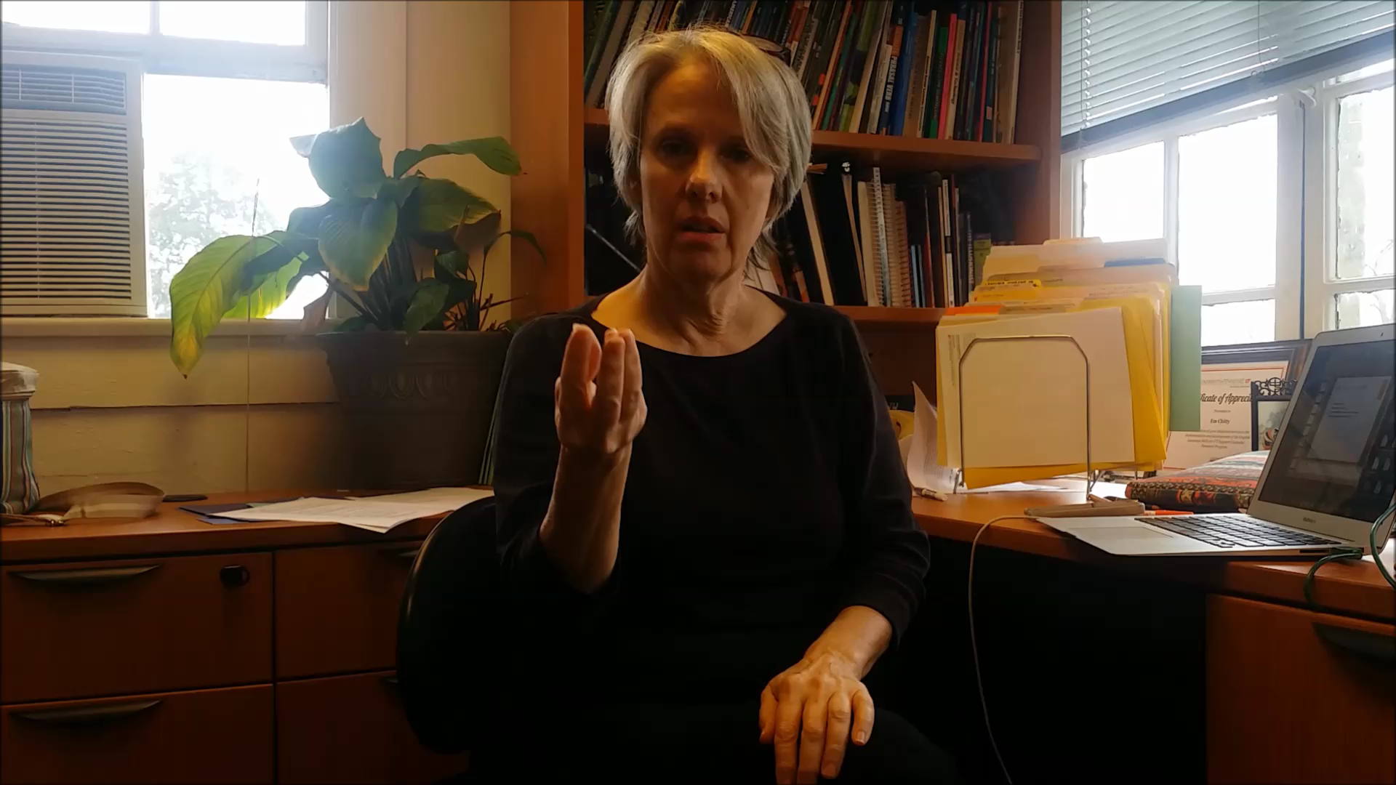
Some
  Fingers pointing up, loosely spread, for “some”

Slide 24
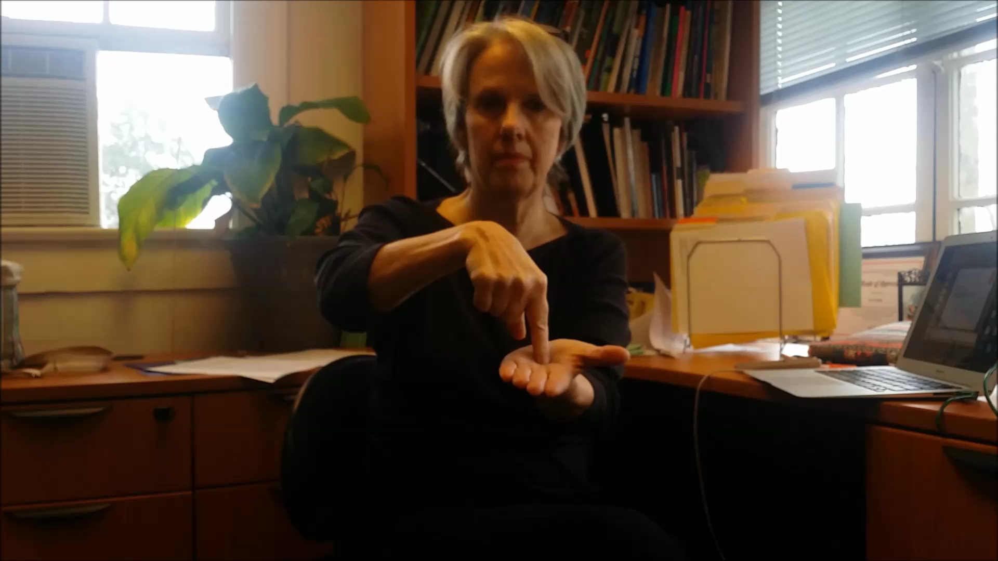
The
  Index finger pointing to palm

Slide 25
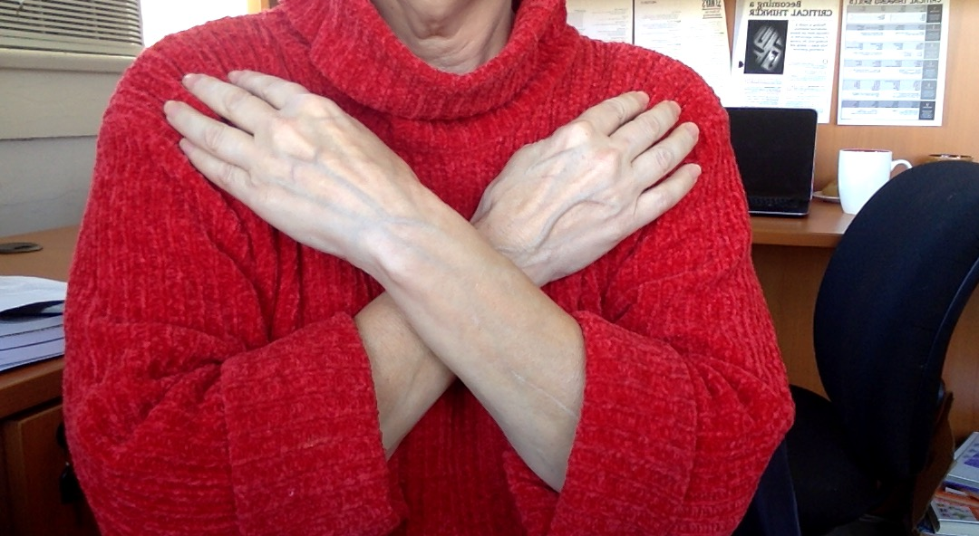
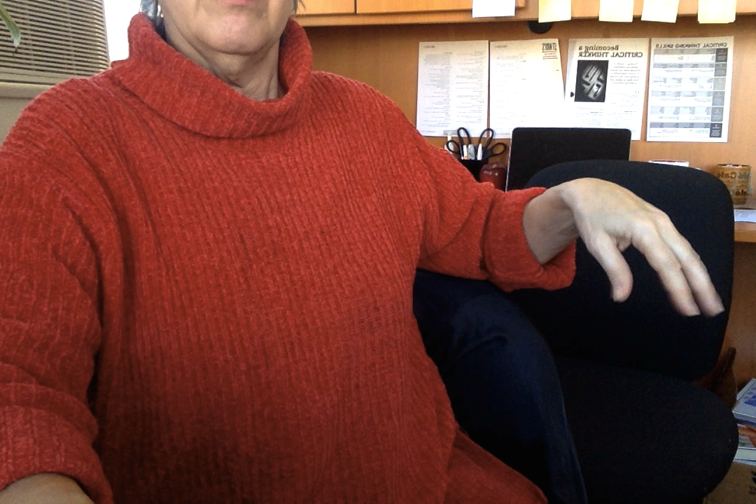
Gestural cues for –ing or –ed in adjectives (the “I am boring” problem)
-ed adjectives, cross hands in front -ing adjectives, hold hand
of chest to indicate “I am feeling…” to side and shake fingers,
“It is interesting to me.”

Slide 26
Metalinguistic Prompts
For –s errors in verbs, make eye contact and simply suggest the proper pronoun, “He?” “She?” “They”?
For failure to use correct tense, use the gesture for the correct tense or prompt: “Use the sentence form….Use the question form”
For failure to use the correct tense helping verb (tense tags), prompt “Use ‘did/do/does” (etc.) or “Use ‘has/have/had’”
For failure to use the correct form of the verb, prompt “Use #1 (present simple) #2 (simple past) #3 (past participle)

Slide 27
Conversation Circles
Set aside two days per week for Conversation Circles.
Best if you have fewer than 10 students because then everyone gets a chance to talk
Students and teacher sit in a circle, not in classroom arrangement, to emphasize authentic communication
Explicit aim, explained to students, is to practice spoken syntactic structures.

Slide 28
Method—First Day
1. Outline/review/refresh the tense you want to work on.
2. Offer students a list of conversation starters in the tense/mode you want to work with.
3. Have students read the questions to each other in pairs.
4. Briefly discuss any comprehension issues.
5. Ask students to circle three questions they would like to answer.

Slide 29
Second Day
Going around the room, ask students to identify a question they’d like to answer.
A student asks them the question.
They answer. As they answer, teacher helps correct the spoken syntax gesturally as much as possible. Try for somewhat extended answers—around three sentences.
During these exchanges, other students take notes on how the linguistic error is resolved.

Slide 30
Spoken Syntax Journal
Error sentence | Resolved sentence
My father married with my mother | My father married my mother
I don’t like the food in here | I don’t like the food here
I went to there last week | I went there last week
The soldier guard the fort | The soldiers guard the fort.

Slide 31
Which students benefit most from this approach?
Even beginning students quickly pick up the gestures. The “be” verb signal is particularly useful for Arabic speakers who tend to leave out the BE verb.
Students practicing tense forms in lower and middle levels
Advanced students with poor spoken syntax.
=
Basically, most students can benefit from some exposure to this approach.

